Slide 1
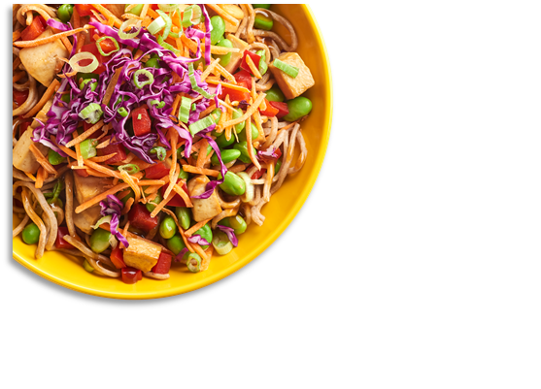
District Logo
December 2024
CAM MIDDLE SCHOOL
MENU
Limited Time Offer:
10-12 Dec
 | MON |  | TUES |  | WED |  | THURS |  | FRI
2 |  | 3 |  | 4 |  | 5 |  | 6
9 |  | 10 |  | 11 |  | 12 |  | 13
16 |  | 17 |  | 18 |  | 19 |  | 20
23 |  | 24 |  | 25 |  | 26 |  | 27
30 |  | 31
Lumberjack
Twin Sausage, Egg & Cheese Breakfast Tacos
A. Mc. Ribb
B. Chicken Parmesan Flatbread
C. Cheese Pizza
Egg & Cheese English Muffin Melt
A. Beef Nachos
B. Corn Dog
C. Pepperoni Pizza
Strawberry Crunch Bagel
Country Chicken Biscuit
A. Horseshoe
B. Popcorn Chicken
C. Sausage Pizza
Sausage & Cheese English Muffin Melt
A. Lumberjack
B. Bean & Cheese Burrito
C. Meat Lovers Pizza
Blueberry Mini Waffle
Country Ham, Egg & Cheese Flatbread
A. Buffalo Ranch Chicken Basket
B. Southwest Chicken Pinwheel Wrap
C. Variety Pizza
Apple Cinnamon Breakfast Round
Country Ham, Egg & Cheese Flatbread
A. Italian Mozzarella Cheese Dunkers
B. Ham Chef Salad
C. Cheese Pizza
Yogurt w/ Animal Crackers
Cheesy Sausage & Egg Burrito
A. Twin Soft Tacos
B. Chicken Tenders
C. LTO Jerk Chicken Pizza
Sausage Breakfast Pizza
Egg & Cheese Muffin Melt
A. Chicken & Noodles
B. Sausage Pizza
C. LTO: Jerk Chicken Pizza
Chicken & Cheese Biscuit
A. French Toast Sticks w/ Sausage Patty
B. LTO: Jerk Chicken Pizza
C. Meat Lovers Pizza
Apple Frudel
Sausage & Cheese Biscuit
A. BBQ Chicken Flatbread
B. Tater Tot Beef Nachos
C. Variety Pizza
Offered Daily @ Breakfast
Fresh Fruit
1% White Milk
Chocolate Milk
100% Fruit Juice
Assorted Cereals w/ Graham Crackers
Cinnamon Chip Scone
Ham, Egg & Cheese Muffin
A. Mini Corn Dogs
B. Parmesan Black Pepper Ranch Burger
C. Cheese Pizza
Pumpkin Bread
Holiday Meal:
Glazed Ham, Mashed or Sweet Potatoes, Green Beans, Apple Crisp
B. Pepperoni Pizza
Confetti Pancakes
Cheesy Ham, Egg & Tater Tot Taco
A. Country Popcorn Chicken Potato Bowl
B. Mc. Ribb
C. Sausage Pizza
Egg & Cheese Bagel Melt
A. Pancakes w/ Sausage Patty
B. Bean & Cheese Burrito
C. Meat Lovers Pizza
Lumberjack
Ham & Cheese Bagel Melt
A. Cheesy Baked Penne Pasta
B. Hot Dog
C. Variety Pizza
Offered Daily @ Lunch
1% White Milk
Chocolate Milk
Cheese & Pepperoni Pizza
Cheeseburger
Chicken Sandwich
Spicy Chicken Sandwich
Sun Butter & Jelly Sandwich
Salad and Deli Sandwich options
Tots or Fries
Christmas Vacation
* Bread is offered with Salads
Menus are subject to change.
All Lunches Must Include Choice of:
Fruits and/or
Vegetable
And May Include:
1% Low-Fat White or Chocolate Milk
This institution is an equal opportunity provider.

